Slide 1


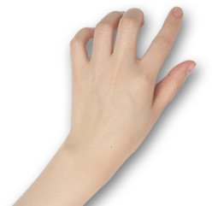

ASoC 2020 Final Report
Provide a separate tutorial for each Arthas command
Songlin Jiang
hollowman@hollowman.ml

Slide 2

1.Who am I
CATALOG
2.What did I do
3.My experience…

Slide 3
First
Who am I ?
Self-introduction

Slide 4
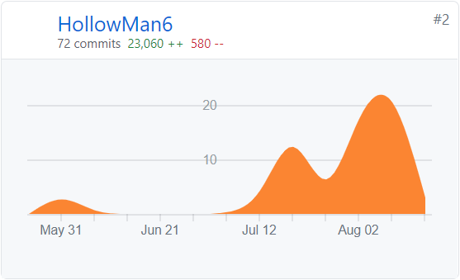


SELF-INTRODUCTION
Songlin Jiang
Lanzhou University
2018 Undergraduate majoring in CS
ASoC 2020 Arthas Community only successful Applicant
My Contributions
My Mentors
Chen Zhixuan
@hengyunabc
Gong Dewei
@kylixs
Alibaba Cloud Senior Engineer, Arthas Developer

Slide 5
Second
What did I do?
Project Requirements
Design Concepts
Deliverables

Slide 6
PROJECT REQUIREMENTS
Move tutorial git Repository to Arthas itself
Seperate the tutorial, provide a separate tutorial for each Arthas command
Update the web page
Add links to the online tutorials for the official documents

Slide 7
DESIGN CONCEPTS
Design Concepts Abstract
1. Use real-world environment to learn and test new technologies in the browser to help developers learn and master best practices.
2. Solve the user's trouble of too troublesome to set up own environment, not having supported environment to try Arthas and the poor operability of the documents and the difficulty of hands-on practice.
Convenient
Straight-forward
Easy
Fast

Slide 8
Deliverables
https://arthas.aliyun.com/doc/arthas-tutorials.html?language=cn

Slide 9
Third
My experience…
Feelings

Slide 10

FEELINGS
Alibaba Summer of Code 2020 has greatly trained my team cooperation and communication skills, broadened my vision, and I gained a lot.
The two mentors also gave me a lot of guiding opinions.
if you have enough enthusiasm for open source, you are recommended to participate in the future Alibaba Summer of Code activities!

Slide 11


THANKS!
Q&A

